Slide 1
DIGITAL PORTFOLIO
NAME:RITVIKA REDDY A.P.
REGISTER NO AND NMID:ASunm1397222406012
DEPARTMENT:B.SC COMPUTER SCIENCE
COLLEGE:SRM ARTS AND SCIENCE
UNIVERSITY:MADRAS UNIVERSITY

Slide 2
INTERACTIVE RESUME
BUILDER USING
HTML
CSS
JAVASCRIPT

Slide 3
PROBLEM STATEMENT
MANY STUDENTS AND PROFESSIONALS LACK AN ONLINE PRESENCE TO SHOWCASE THEIR SKILLS,PROJECT AND ACHIEVEMENTS EFFECTIVELY . A PERSONAL WEBSITE HELPS IN CREATING A DIGITAL IDENTITY AND PORTFOLIO.

Slide 4
PROJECT OVERVIEW
THIS PROJECT DEMOSTRATES HOW TO MAKE A INTERACTIVE RESUME BUILDER USING:
HTML FOR STRUCTURE
CSS FOR STYLING
JAVASCRIPTS FOR INTERACTIVE
IT PROVIDES A PLATFORM TO SHOW CASE PROJECTS,SKILLS AND CONTACT DETAILS

Slide 5
END USERS
JOB SEEKERS
PROFESSIONALS
INDIVIDUALS IN DEMANDING FIELDS
THOSE LOOKING TO DIFFERENTIATE THEMSELVES

Slide 6
TOOLS AND TECHNOLOGIES
HTML
CSS
JAVASCRIPTS
VISUAL STUDIO CODE
CANVAS

Slide 7
PORTFOLIO DESIGN AND LAYOUT
Prioritize clear navigation
Select a professional
Readable font
Use a clean color scheme that enhances legibility

Slide 8
FEATURES AND FUNCTIONALLY
MULTIMEDIA ELEMENTS
PERSONALIZED BRANDING
PROFESSIONAL
INTERACTIVE SECTIONS
USER FRIENDLY INTERFACE
CONTENT INPUT&EDITING
RESPONSIVE DESIGN
SHARING CAPABILITY

Slide 9
result
An interactive resume builder is a dynamic, online,digital document that goes beyond a traditional static resume using rich media and interactive elements like pop-up windows,videos,and embedded portfolios to showcase a candidate’s skills and personality to potential employers.

Slide 10
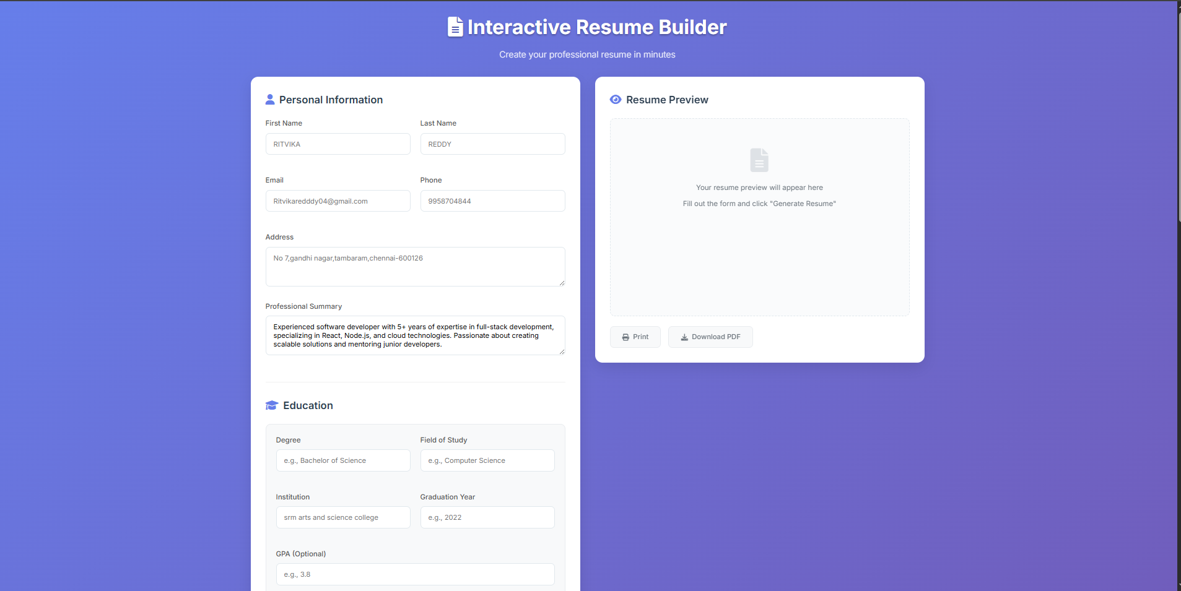

Slide 11
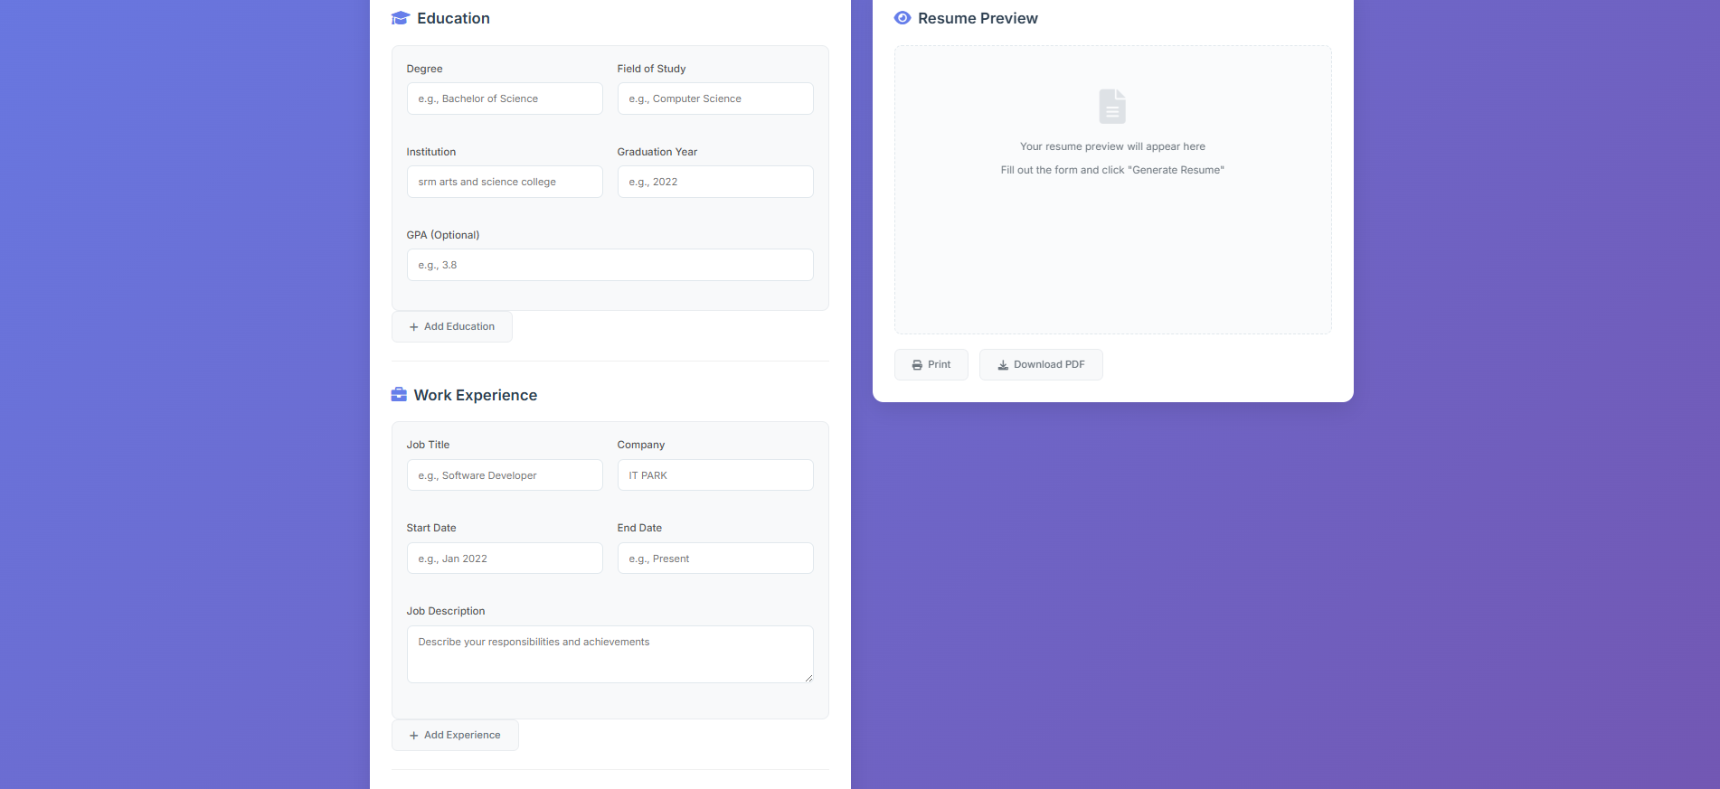

Slide 12
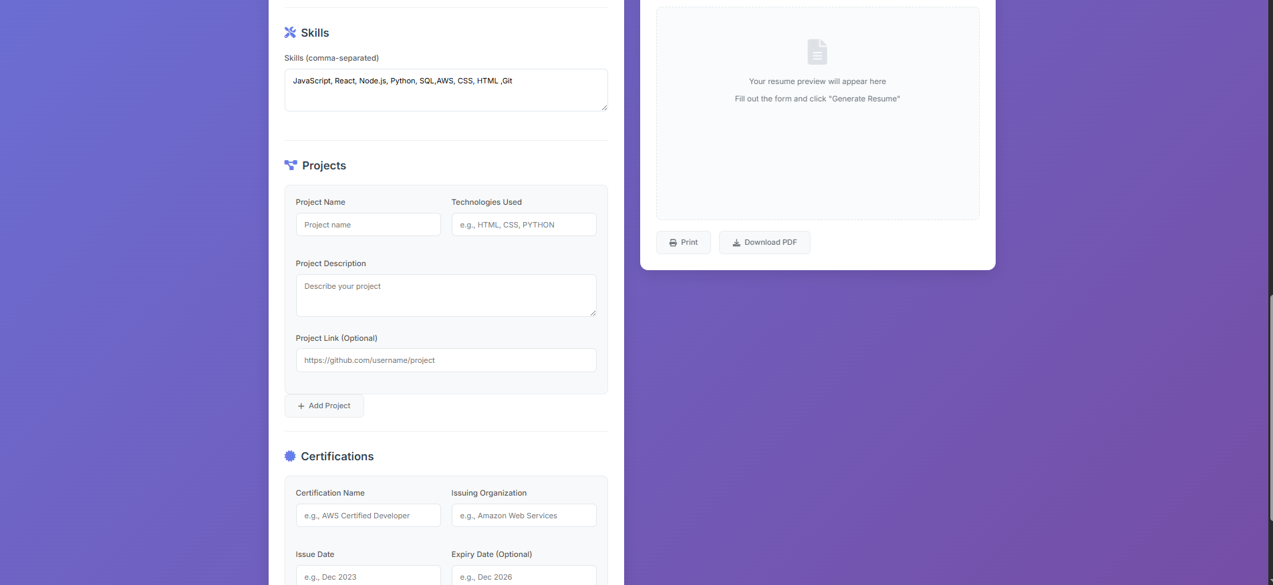

Slide 13
conclusion
A concluding statement for an interactive resume should emphasize the job seeker’s relevant skills and qualification , express enthusiasm for the role and include a clear call to action,such as ;looking forward to an interview to disscuss how they can contribute to the the company.

